Slide 1
DEEP LEarNiNg MastEr Class
Day-16

Slide 2
Announcement
Attendance Link will be Available around 7:30 PM

Slide 3
01
Deep Learning frame works
Concept

Slide 4
frameworks
Frameworks | Written Language | CUDA Support | Pretrained Model | Release Year
TensorFlow | C++, Python | Yes | Yes | 2015
Keras | Python | Yes | Yes | 2015
PyTorch | Python, C | Yes | Yes | 2016
Caffe | C++ | Yes | Yes | 2013
Deeplearning4j | C++, Java | Yes | Yes | 2014

Slide 5
Deep Learning Terminology - 1
Gradient Clipping
Gradient Clipping is one way to solve the problem of exploding gradients.
Exploding gradients arise in deep networks when gradients associating weights and the net’s error become too large.
Exploding gradients are frequently encountered in RNNs dealing with long-term dependencies.
One way to clip gradients is to normalize them when the L2 norm of a parameter vector surpasses a given threshhold.

Slide 6
Deep Learning Terminology - 2
GRU (Gated recurrent unit)
A GRU is a pared-down LSTM. GRUs rely on gating mechanisms to learn long-range dependencies while sidestepping the vanishing gradient problem.
They include reset and update gates to decide when to update the GRUs memory at each time step.
GRU is simplified LSTM

Slide 7
Deep Learning Terminology - 3
Word2Vec
Word2vec is a two-layer neural net that processes text.
Its input is a text corpus and its output is a set of vectors: feature vectors for words in that corpus.
While Word2vec is not a deep neural network, it turns text into a numerical form that deep nets can understand

Slide 8

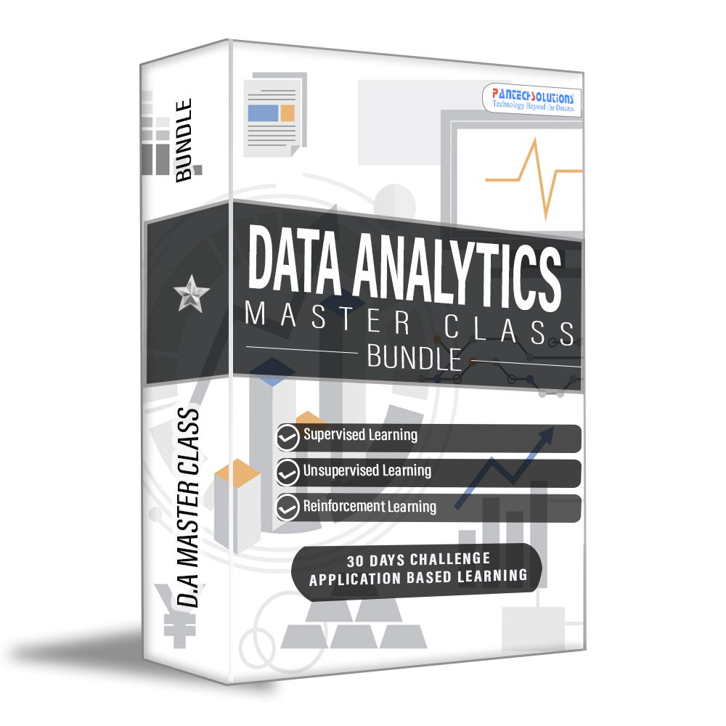
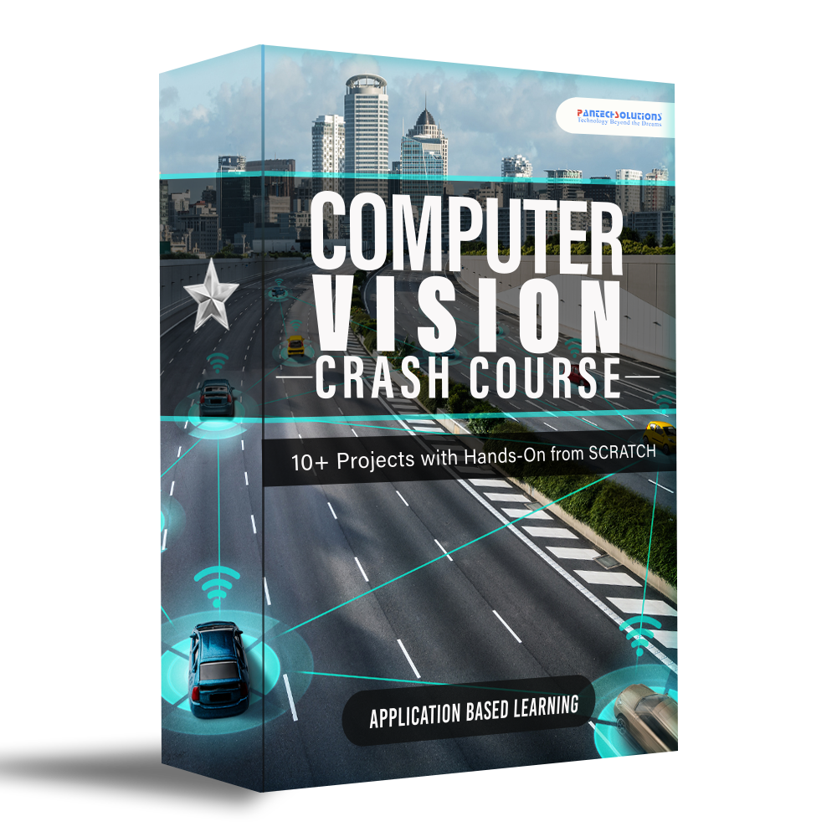
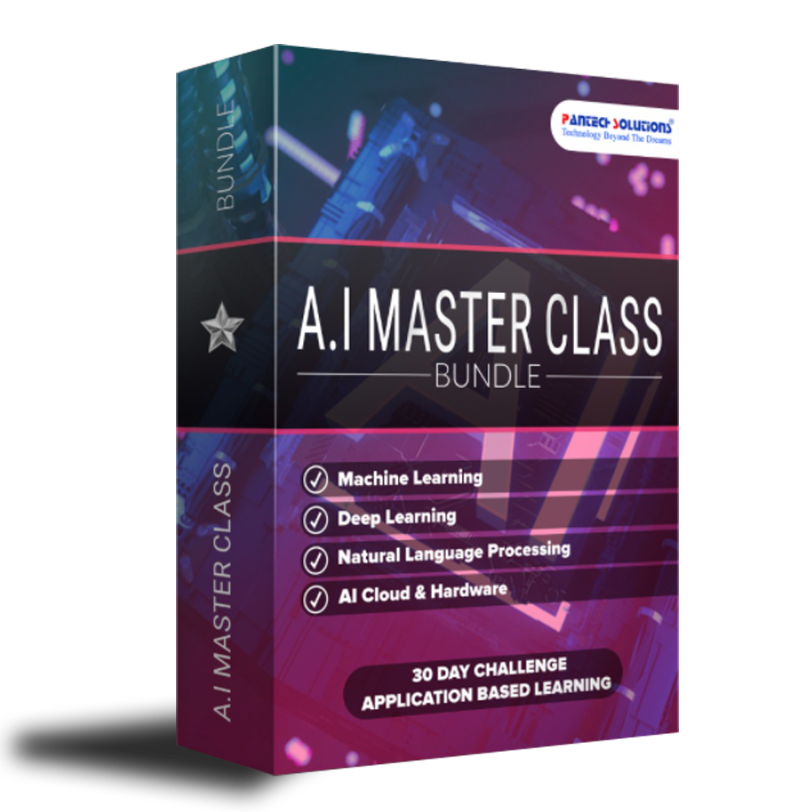
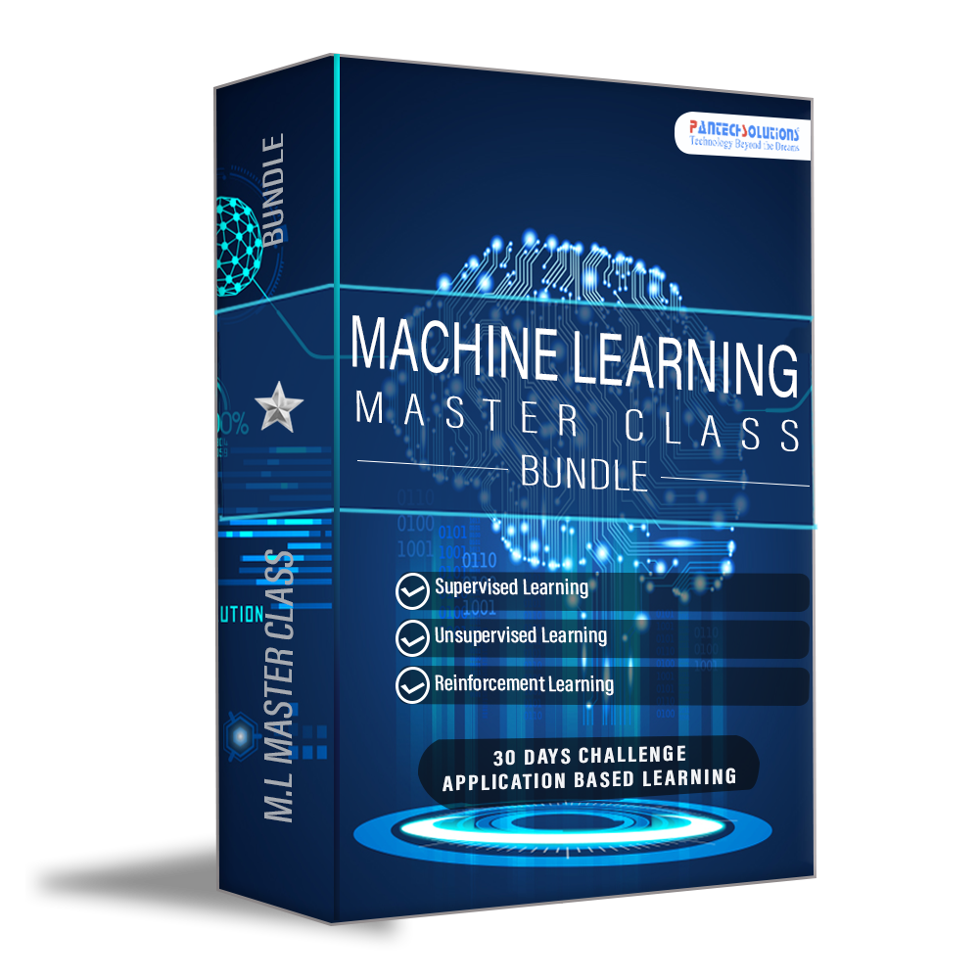
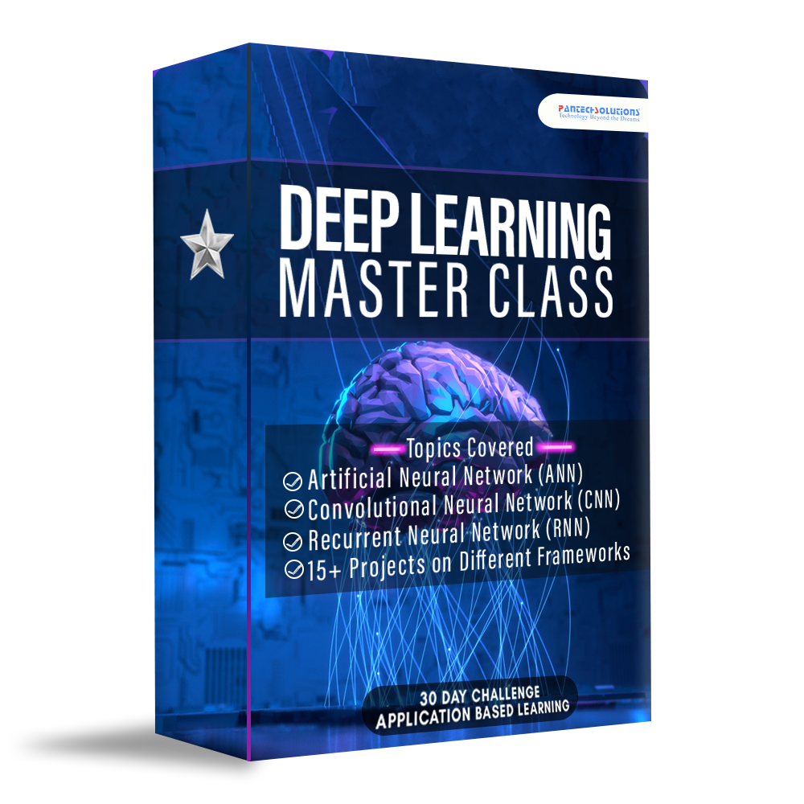
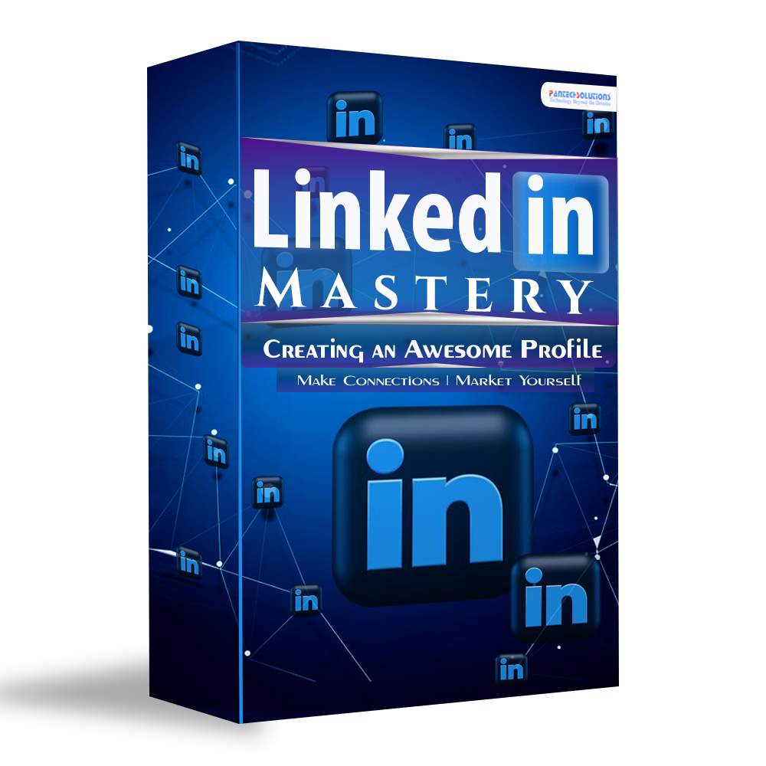
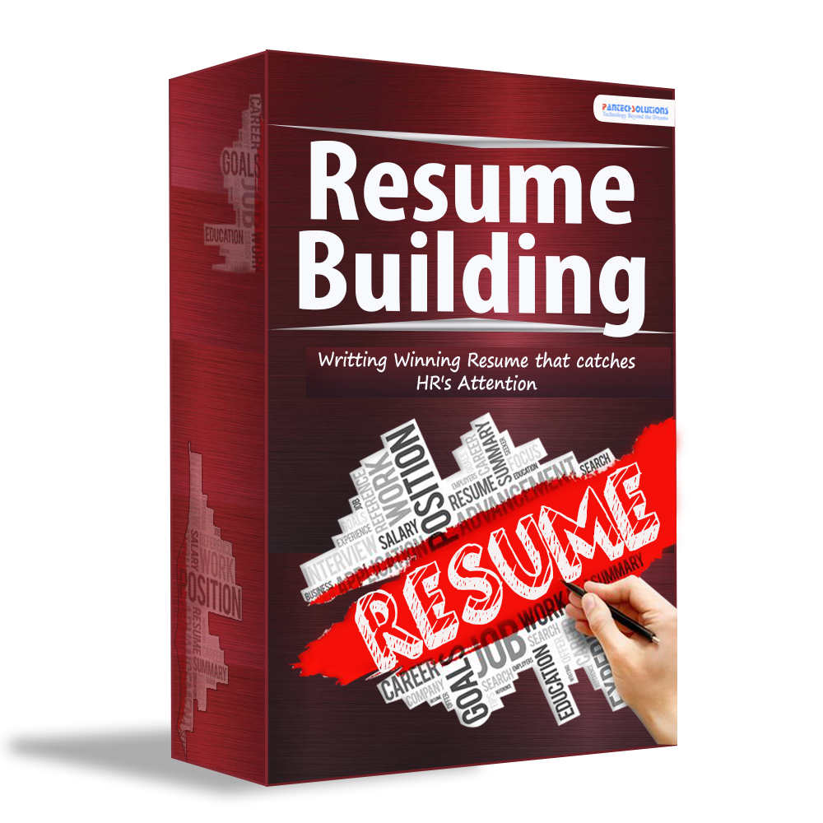

Data Science

Slide 9
Quotes
Short bytes – D16
So Get things Done ! Do Not Postpone It or Wait until Your Good Mood Come
Good mood depends on our actions we take when we are in a Bad Mood

Slide 10
Q & A Session

Slide 11
Thanks!
Thanks!
Follow Me on LinkedIn : Link in Description
+91 7305845758
Pantechsolutions.net
Ask Your Friends to Participate on this Event

